Slide 1
Interactive web applications with R shiny
SWFSC

Slide 2
Operationalizing EcoCast
AVISO+
CMEMS
ERDDAP
Finalized workflow
Ideal workflow
that doesn’t currently exist
2
4a
2
2
Official EcoCast output netcdf
(n=1/day)
3a
Website similar to WhaleWatch
5a
Daily
Cron job
1
EcoCast R scripts and models
3a
Online storage
Official EcoCast output (n=1/day)
4b
3a
Intermediate outputs (n=5/day)
5b
EcoCast tool
Lasdev server in Santa Cruz
0
Notes:
0. Entire EcoCast process is hosted on the Lasdev server in Santa Crus
1. A daily cron job initiates a series of R scripts
2. Real-time environmental data are acquired from online sources
3a. EcoCast outputs are created for the day
4a. Netcdf is uploaded to ERDDAP where users can access official real-time and historical geospatial outputs
4b. EcoCast outputs are uploaded to online storage (OceanView)
5a. Image is uploaded to a site similar to WhaleWatch
5b. Rshiny app accesses intermediate data stored online as required by users

Slide 3
EcoCast Tool
Try it for yourself: https://heatherwelch.shinyapps.io/rshinyapp_historical/

Slide 4
EcoCast Tool
ui <- shinyUI(
-aesthetics
-user inputs
)
server <- shinyServer( {
-what to do with user inputs
) }

Slide 5
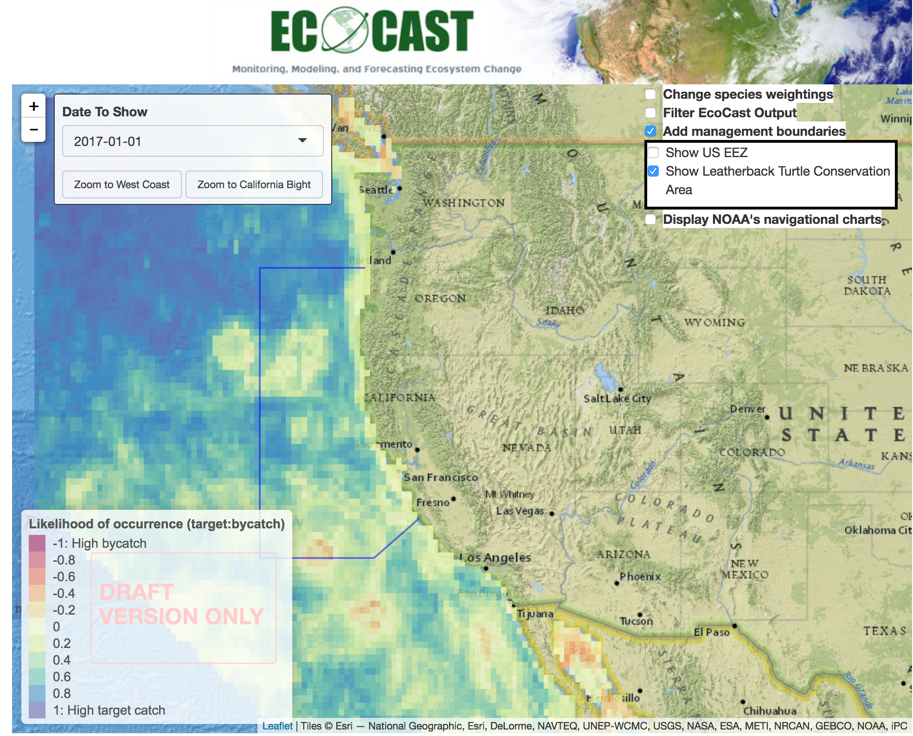
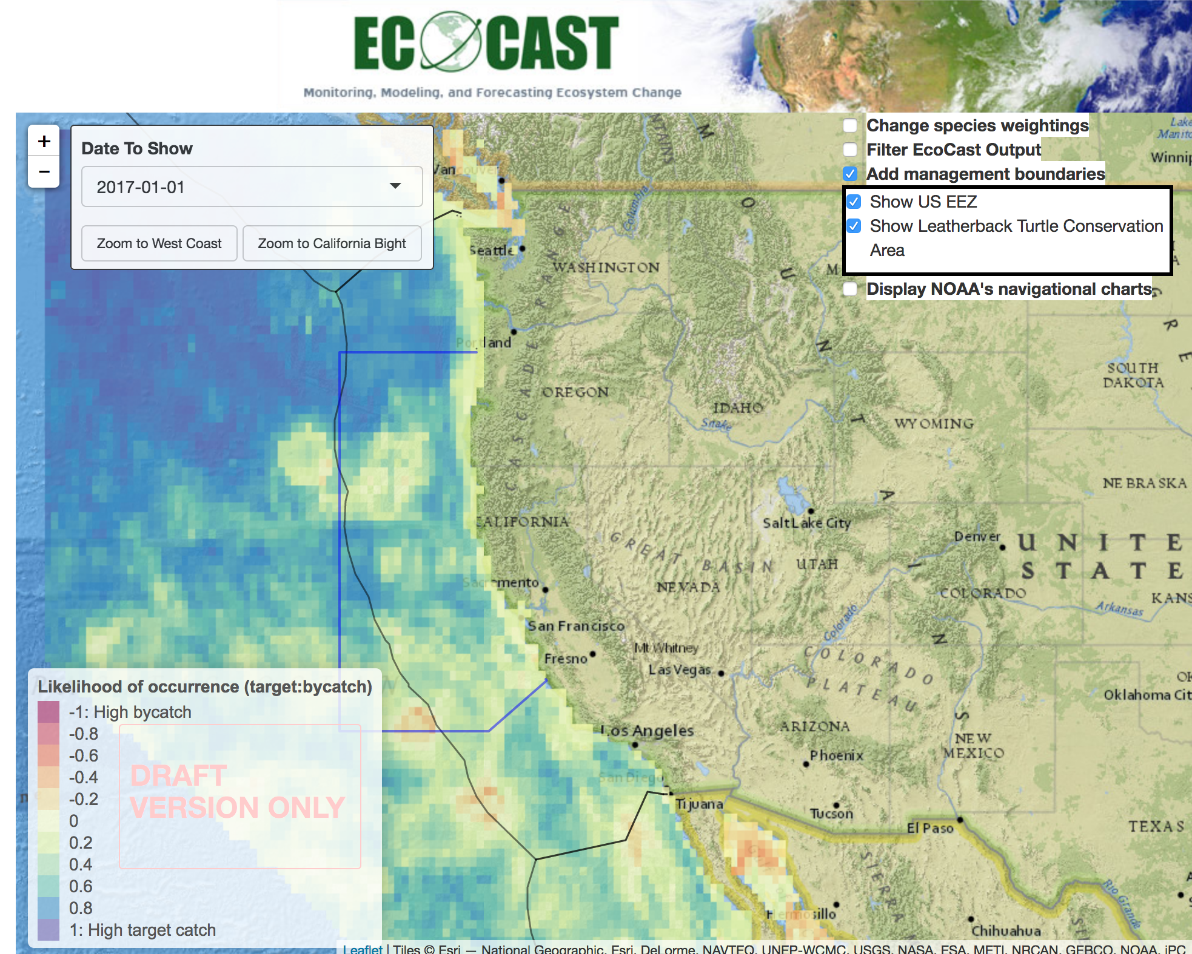
EcoCast Tool

